Slide 1


<Name>
<Date>

Slide 2

Outline
Executive Summary
Introduction
Methodology
Results
Conclusion
Appendix

Slide 3
Executive Summary
Summary of methodologies
Data collection API
Data collection Web Scraping
Data Wrangling
Exploratory Analysis using SQL
Exploratory Analysis using Visualisation
Analytics with Folium
Interactive Dashboard with Plotly Dash
Machine Learning Prediction
Summary of all results
We have produced logistic Regression, Support Vector Machine, Decision Tree Classifier, K-Nearest Neighbours
All models produced the same result with an accuracy rate of 83.33%
Successful landings were predicted by all models
Requires better data to determine the accuracy of the models

Slide 4
Introduction
Project background and context
Predict Falcon9 first stage will have a successful landing
Cost of launch is $62 million as advertised by SpaceX on their website, in comparison, other providers cost $165 million as SpaceX can reuse the first stage of launch
If we can predict the whether the first stage will be successful, then we can predict the total cost of the launch
Problems you want to find answers
What factors determines whether a launch will be successful or not
Correlation between variables of a rocket and the success rate
What SpaceX needs to consider in order to ensure the highest success rate

Slide 5

Section 1

Slide 6
Methodology
Executive Summary
Data collection methodology:
Web Scraping via Wikipedia
SpaceX rest API
Perform data wrangling
One Hot Encoding data fields for Machine Learning and dropping irrelevant columns
Perform exploratory data analysis (EDA) using visualization and SQL
Plotting: Scatter Graphs, Bar Graphs to examine the relationships between variables and show trends
Perform interactive visual analytics using Folium and Plotly Dash
Perform predictive analysis using classification models
How to build, tune, evaluate classification models

Slide 7
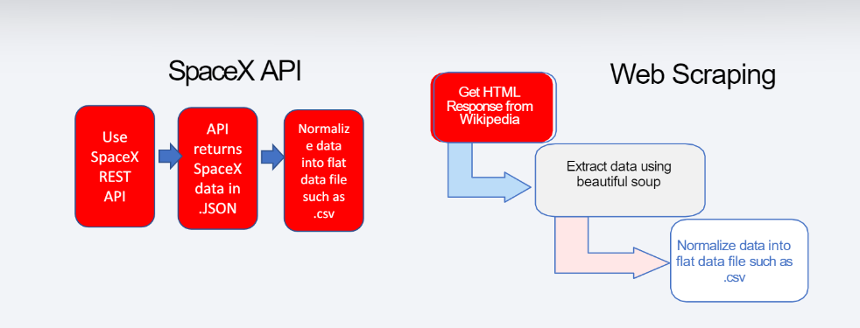
Data Collection
Describe how data sets were collected.
Web Scraping Falcon 9 Launch Data via Wikipedia
Data gathering from SpaceX Rest API
You need to present your data collection process use key phrases and flowcharts

Slide 8
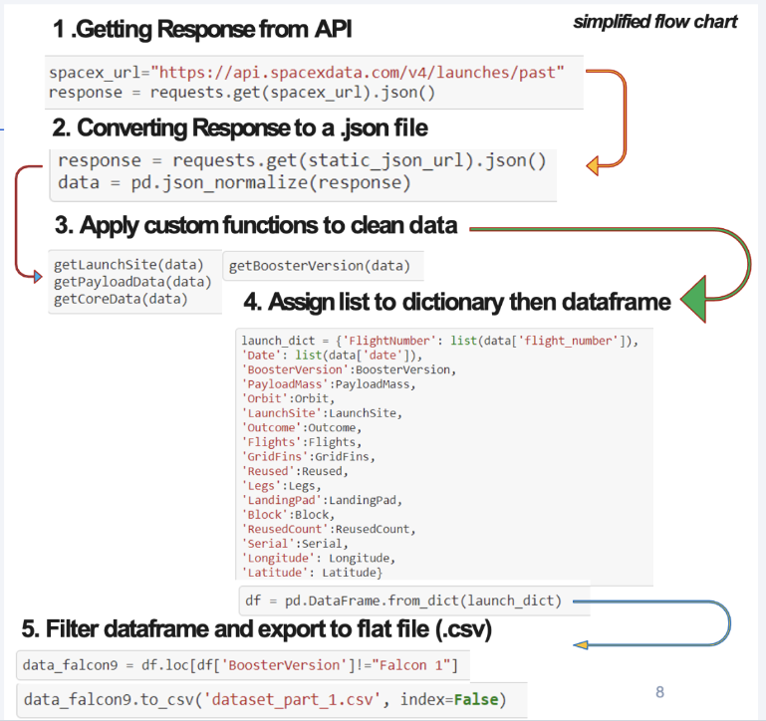

Data Collection – SpaceX API
GitHub URL: IBM-Applied-Data-Science-Capstone/jupyter-labs-spacex-data-collection-api.ipynb at main · RebeccaHuo/IBM-Applied-Data-Science-Capstone (github.com)
Place your flowchart of SpaceX API calls here

Slide 9
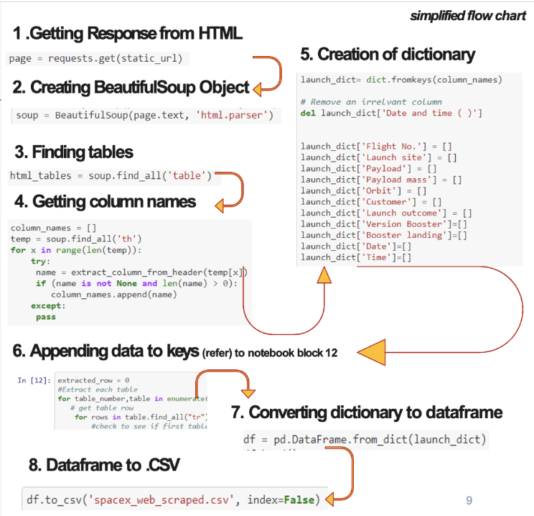
Data Collection - Scraping
GitHub URL: IBM-Applied-Data-Science-Capstone/jupyter-labs-webscraping.ipynb at main · RebeccaHuo/IBM-Applied-Data-Science-Capstone (github.com)
Place your flowchart of web scraping here

Slide 10
Data Wrangling
Describe how data were processed:
There were a couple of occasions where the booster did not land successfully.
Accidents have also happened where it vetoed a successful launch
We separated the outcomes into True Ocean and False Ocean as successful landing in a specific region and unsuccessful landing in a specific region respectively
We label the outcomes as 1 and 0 as successful and unsuccessful respectively
Data process wrangling:
Exploratory Data Analysis
Calculate the number of launches on each sites
Calculate the number and occurrence of each orbit
Calculate the number and occurrence of mission outcome per orbit type
Create a landing outcome label from Outcome column and determine success rate
Export to CSV
GitHub URL: IBM-Applied-Data-Science-Capstone/labs-jupyter-spacex-Data wrangling.ipynb at main · RebeccaHuo/IBM-Applied-Data-Science-Capstone (github.com)

Slide 11
EDA with Data Visualization
Summarize what charts were plotted and why you used those charts
EDA was performed on variables including: Flight Number, Payload Mass, Launch Site, Orbit, Class and Year
The plots were: Flight Number-Payload Mass, Flight Number-Launch Site, Payload Mass-Launch Site, Orbit-Success Rate, Flight Number-Orbit, Payload-Orbit and Success Yearly Trend
We used Bar charts, scatter plots and line charts to determine relationship between the variables
GitHub URL: IBM-Applied-Data-Science-Capstone/jupyter-labs-eda-dataviz.ipynb.jupyterlite.ipynb at main · RebeccaHuo/IBM-Applied-Data-Science-Capstone (github.com)

Slide 12
EDA with SQL
Summary of SQL queries performed:
Display the names of the unique launch sites in the space mission
Display 5 records where launch sites begin with the string “CCA”
Display the total payload mass carried by boosters launched by NASA (CRS)
Display average payload mass carried by booster version F9 v1.1
List the date when the first successful landing outcome in ground pad was achieved
List the names of the boosters which has success in drone ship and have payload mass greater than 4000 but less than 6000
List the total number of successful and failure mission outcomes
List the names of the booster versions which have carried the maximum payload mass#
List the records which will display the month names, failure landing_outcomes in drone ship, booster versions, launch_site for the months in year 2015
Rank the count of successful landing_outcomes between the date 04/06/2010 and 20/03/2017 in descending order
GitHub URL: IBM-Applied-Data-Science-Capstone/jupyter-labs-eda-sql-coursera_sqllite.ipynb at main · RebeccaHuo/IBM-Applied-Data-Science-Capstone (github.com)

Slide 13
Build an Interactive Map with Folium
Map object summaries:
Use Longitude and Latitude coordinates to mark all launch sites with circle marker around each site with the name of the site
Success/Failure of the launch on the map:
Refer back to the 1 and 0 as success and failure, with Green and Red marks using MarkerCluster()
Distance between a launch site to its proximities:
Using Haversine’s formula to calculate the distance from the Launch Site to its proximities such as highway, roadway, coastline. With lines drawn on the map to measure the distance
Explain why you added those objects
GitHub URL: IBM-Applied-Data-Science-Capstone/lab_jupyter_launch_site_location.jupyterlite.ipynb at main · RebeccaHuo/IBM-Applied-Data-Science-Capstone (github.com)

Slide 14
Build a Dashboard with Plotly Dash
This Plotly Dash application allows users to perform interactive visual analytics on SpaceX launch data in real-time
Scatter plot displays the relationship Payload Mass and Launch Outcome for the different Booster Versions – It displays correlation and range of data
Pie Chart used to show the total launched by a specific site/all sites
Displays relative proportion of multiple classes of data and size of the circle can be made proportional to the total quantity it represents
GitHub URL: IBM-Applied-Data-Science-Capstone/Plotly Dash at main · RebeccaHuo/IBM-Applied-Data-Science-Capstone (github.com)

Slide 15
Predictive Analysis (Classification)
Summary of Model Building:
Load data into Panda and NumPy
Split dataset into training and test sets and check the samples
Determine the type of machine learning algorithms we want to use
Set our parametres and algorithms to GridSearchCV
Fit our datasets into the GridSearchCV objects and train model with dataset
Model Evaluation:
Check accuracy for each period
Optimise hyperparametres for each model
Produce confusion matrix
Model Improvement:
Feature engineering
Algorithm Tuning
Identify the best performing algorithm
GitHub URL: IBM-Applied-Data-Science-Capstone/SpaceX_Machine_Learning_Prediction_Part_5.jupyterlite.ipynb at main · RebeccaHuo/IBM-Applied-Data-Science-Capstone (github.com)

Slide 16
Results
Exploratory data analysis results
Interactive analytics demo in screenshots
Predictive analysis results

Slide 17

Section 2

Slide 18
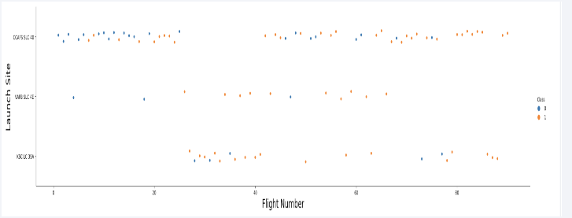
Flight Number vs. Launch Site
Scatter plot of Flight Number vs. Launch Site
Launch sites with higher number of flights correlates to greater success rate at the particular launch site

Slide 19
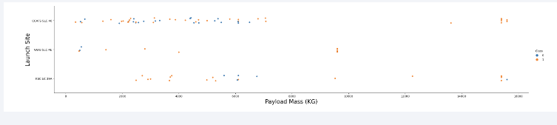
Payload vs. Launch Site
Scatter plot of Payload vs. Launch Site
Payload-Launch Site scatter point chart shows that VAFB-SLC launch site there are no rockets launched for heavy payload mass > 10,000

Slide 20
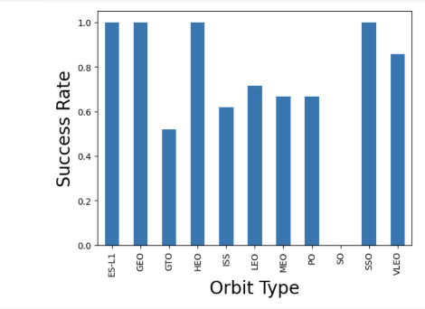
Success Rate vs. Orbit Type
Bar chart for the success rate of each orbit type
Orbit type GEO, HEO, SSO, ES-L1 have the highest success rate

Slide 21
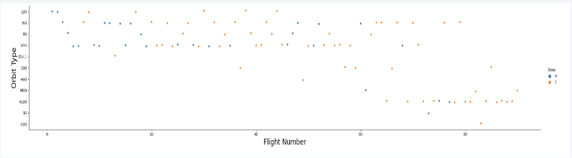
Flight Number vs. Orbit Type
Scatter point of Flight number vs. Orbit type
LEO orbit the success appears related to the number of flights. But there seems to be no relationship between flight number when in GTO orbit

Slide 22
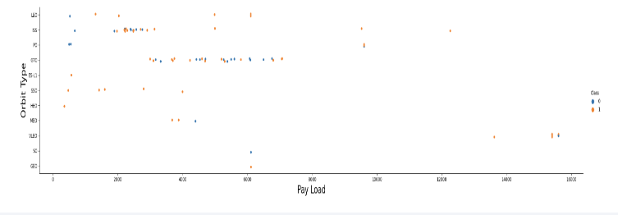
Payload vs. Orbit Type
Scatter point of payload vs. orbit type
The higher the payload, the more successful landing rate at Polar, LEO and ISS. However for GTO we can’t differentiate this well for positive and negative landing rate

Slide 23
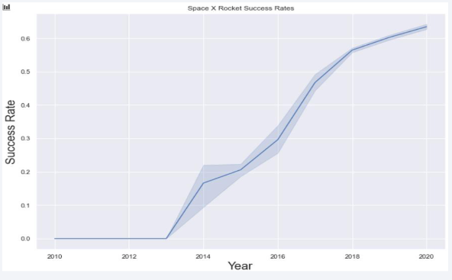
Launch Success Yearly Trend
Line chart of yearly average success rate
We can see a consistently increasing success rate between 2013 - 2020

Slide 24
All Launch Site Names
SQL Query: SELECT DISTINCT Launch_Site FROM SPACEXTBL
Launch Site:
CCAFS LC-40
CCAFS SLC-40
KSC LC-39A
VAFB SLC-4E
Distinct will filter the data so only unique launch sites are showing from Launch_Site column from SPACEXTBL

Slide 25
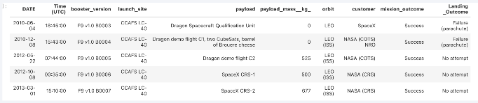
Launch Site Names Begin with 'CCA'
5 records where launch sites begin with `CCA`
Query result with a short explanation:
Use LIMIT 5 to find 5 records, using LIKE as a wild card to find launch sites beginning with ‘CCA’

Slide 26
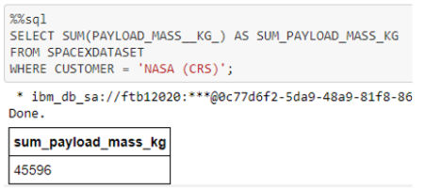
Total Payload Mass
Calculate the total payload carried by boosters from NASA
Query result with a short explanation:
This sums the total payload mass where NASA’s the customer
CRS is Commercial Resupply Services which indicates that these payloads were sent to the International Space Station (ISS)

Slide 27
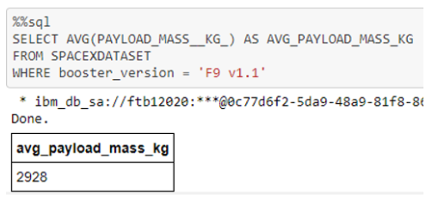
Average Payload Mass by F9 v1.1
Calculate the average payload mass carried by booster version F9 v1.1
Query result with a short explanation:
This calculates the average payload mass or launches which used booster version F9 v1.1
Average payload mass of F9 1.1 is on the low end of the payload mass range

Slide 28
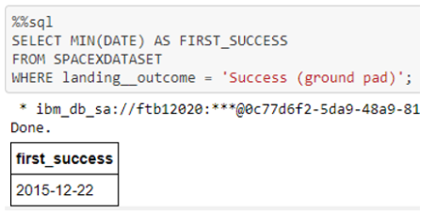
First Successful Ground Landing Date
Find the dates of the first successful landing outcome on ground pad
Query result with a short explanation:
This gives the first successful ground pad landing date
First ground pad landing was not until the end 2015
Successful landings in general appear starting in 2014

Slide 29
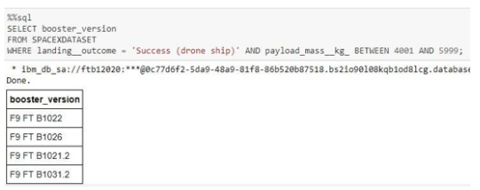
Successful Drone Ship Landing with Payload between 4000 and 6000
List the names of boosters which have successfully landed on drone ship and had payload mass greater than 4000 but less than 6000
Query result with a short explanation:
This returns the 4 booster versions that had successful drone ship landings with a payload mass between 4000 and 6000

Slide 30
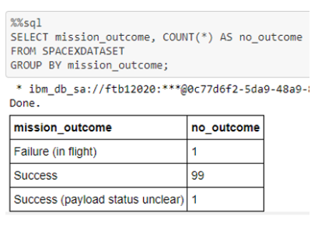
Total Number of Successful and Failure Mission Outcomes
Calculate the total number of successful and failure mission outcomes
Query result with a short explanation:
This returns a count of each mission outcome
SpaceX achieves a mission of nearly 99%, meaning most of the landing failures are intentional
One launch has an unclear payload status and one failed flight

Slide 31
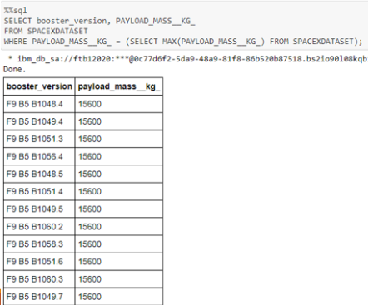
Boosters Carried Maximum Payload
List the names of the booster which have carried the maximum payload mass
Query result with a short explanation:
This shows that booster versions carried the highest payload mass of 15600kg and booster versions are very similar and all are F9 B5 B10xx.x

Slide 32
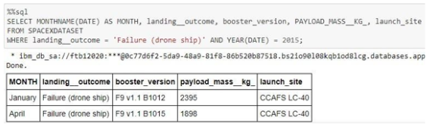
2015 Launch Records
List the failed landing_outcomes in drone ship, their booster versions, and launch site names for in year 2015
Query result with a short explanation:
This returns the Month, Landing_Outcome, Booster_Version, Payload_Mass_KG, and Launch site of 2015 where stage 1 failed to land on a drone ship

Slide 33
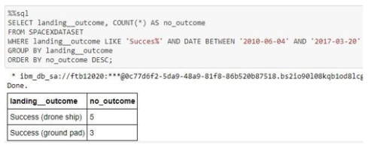
Rank Landing Outcomes Between 2010-06-04 and 2017-03-20
Rank the count of landing outcomes (such as Failure (drone ship) or Success (ground pad)) between the date 2010-06-04 and 2017-03-20, in descending order
Query result with a short explanation:
This returns a list of successful landing between 04/06/2010 and 20/03/2017. There are 2 types of successful landing: drone ship or ground pad landings.
There were 8 successful launches during this period

Slide 34

Section 3

Slide 35
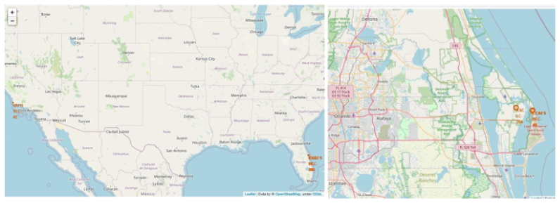
Launch Site Locations
The map on the left shows all launch sites in US map
The map on the right shows the 2 Florida launch sites
All launch sites are near the ocean

Slide 36
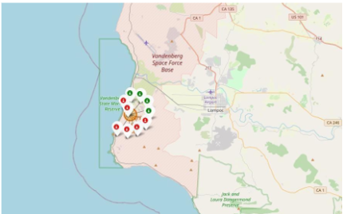
Colour-Coded Launch Markers
Clusters on Folium map can be clicked as they are interactive and display each successful landing with green buttons and unsuccessful as red buttons
This is an example where VAFB SLC-4E shows 4 successful landings and 6 failed landings

Slide 37
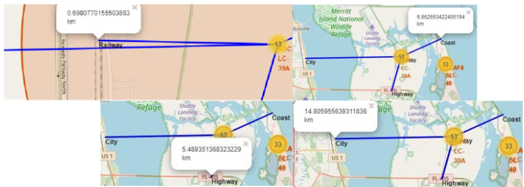
Key Location Proximities
KSC LC-39A is an example where the launch site is very close to highways and railways
Usually launch sites are near the coasts and far from highly dense population areas to avoid accidents and rockets falling on populated areas

Slide 38

Section 4

Slide 39
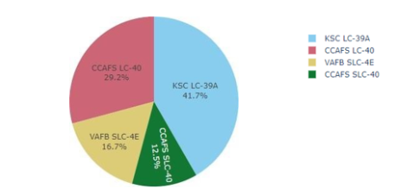
Successful Launches Across Launch Sites
Above graph shows a distribution of successful landings across all launch sites.
CCAFS LC-40 is the old name of CCAFS SLC-40 so CCAFS and KSC have the same amount of successful landings
VAFB has the smallest share of successful landings which could be due to smaller sample and increase in difficulty of launching in the west coast

Slide 40
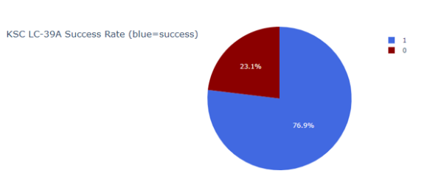
Highest Success Rate Launch Site
KSC LC-39A has the highest success rate with 10 successful landings and 3 failed landings

Slide 41
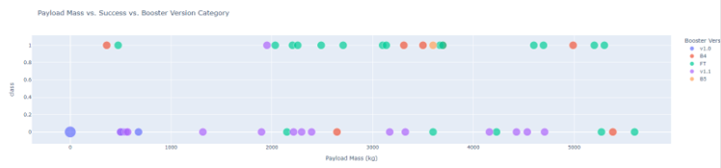
Payload Mass vs. Success vs. Booster Version Category
Plotly dashboard has a Payload range selector
This ranges from 0 to 10,000 instead of the max Payload of 15,600
Class indicates 1 for successful landing and 0 for failure
Scatter plot also accounts for booster version category in colour and number of launches in point size
This particular range of 0 to 6,000 and there are 2 failed landings with payloads of 0 kg

Slide 42

Section 5

Slide 43
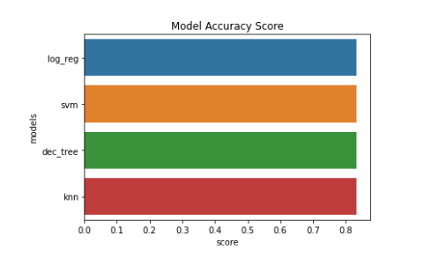
Classification Accuracy
All models had virtually the same accuracy on the test set at 83.33%
It should be noted that test size is small at only sample size of 18
This can cause large variance in accuracy results, such as those in Decision Tree Classifier model in repeated runs
W probably need more data to determine the best model

Slide 44
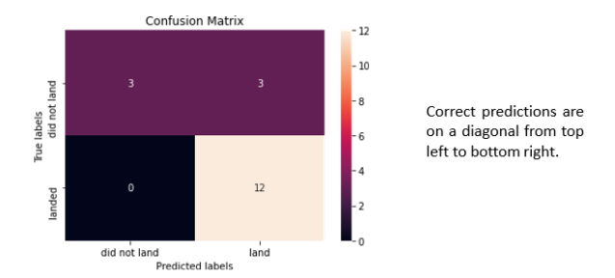
Confusion Matrix
All models performed the same for the test set, the confusion matrix is the same across all models
The models predicted 12 successful landings, 3 unsuccessful landings and 3 successful landings when the true label was unsuccessful landings

Slide 45
Conclusions
We were asked to develop a machine learning model to evaluate Falcon 9 including the variables that can affect the success rate of Falcon 9’s first stage launch
Gather data through web scraping via Wikipedia and SpaceX Rest API
Create Dashboard for visualization
Created machine learning models for comparison all with an accuracy of 83%
Where possible, we need more data to better determine the best machine learning model and improve accuracy

Slide 46
Appendix
All Python, Jupyter codes and graphs can be found via the GitHub repository with the below URL: RebeccaHuo/IBM-Applied-Data-Science-Capstone (github.com)
Special thanks to all instructors, IBM and Coursera

Slide 47


